Slide 1




DIGITAL EXCLUSION PREDICTS WORSE MENTAL HEALTH AMONG ADOLESCENTS DURING COVID-19
Tom Metherell
University of Cambridge
12th July 2022
temj3@cantab.ac.uk
digitalmentalhealth.group
@tom_metherell
Notes:
Introduction (30 sec.)
Key points: - QR code links to preprint

Slide 2
OUTLINE
Overall state of adolescent mental health
1
Mental health associations of digital technologies during COVID-19
2
3
Discussion of findings
Significance in an increasingly digitalised world
4
Notes:
Self-explanatory
Linger on this slide! Lay out roadmap

Slide 3


OVERALL STATE OF UK ADOLESCENT MENTAL HEALTH
2017
2020
Has a probable mental disorder
Vizard et al. (2020)
Notes:
Key points: - Data is from national NHS survey of Mental Health in Children & Young People. 1 in 9 had a probable mental health disorder in 2017, up to 1 in 6 in 2020. Context is therefore of a significantly increased incidence of mental health symptoms in the COVID-19 pandemic.

Slide 4
UNDErstanding society YOUTH SURVEY data
​ | Fieldwork dates | N
Pre-pandemic | 2017–19 | 2 821
During COVID-19 pandemic | July 2020​ | 1 411​
Q3 | November 2020 | 1 432
Q4 | March 2021 | 1 388
University of Essex (2021a, 2021b)
Notes:
We can further assess the overall state of adolescent mental health before & during the pandemic using data from Understanding Society. US uses the Strengths & Difficulties Questionnaire to assess the levels of mental health symptoms. Here are the waves for which US collected adolescent mental health data…

Slide 5
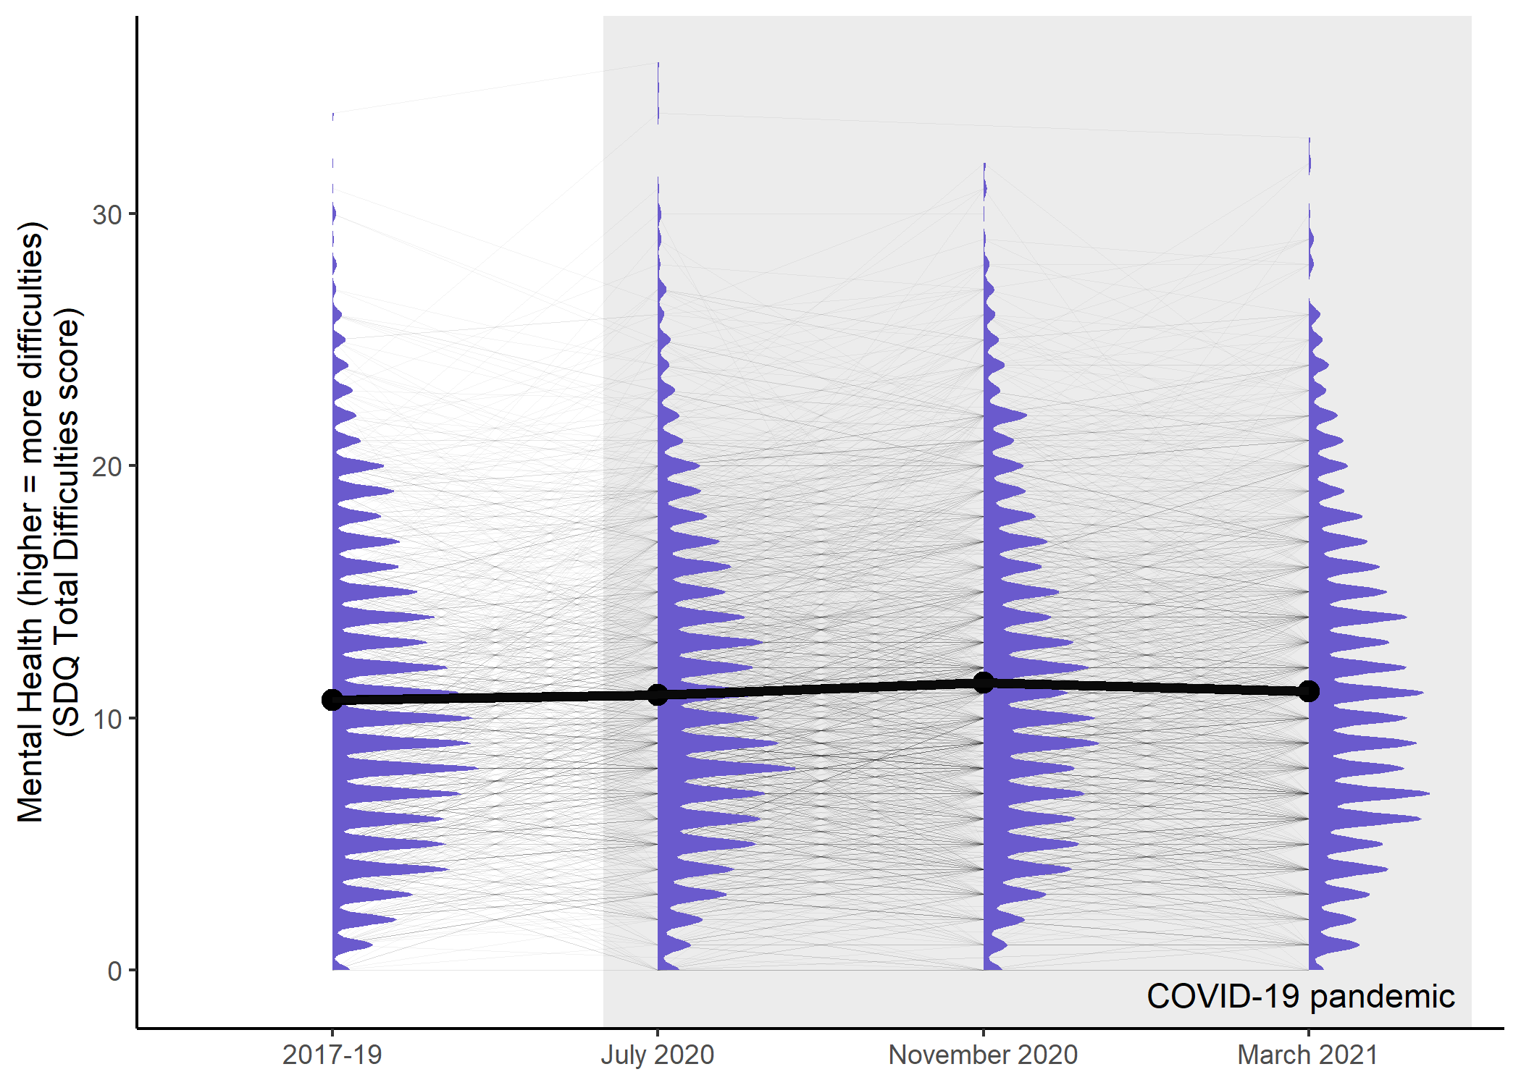
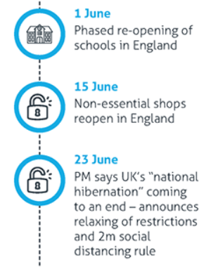
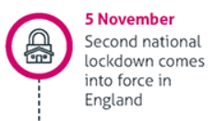
UNDErstanding society YOUTH SURVEY data
Institute for Government (2021); Metherell et al. (2021)
Notes:
Describe features of graph in painstaking detail (black line is mean SDQ score). Note in particular: July 2020 coincides with relaxing of first wave of restrictions in England (vast majority of UK population); November 2020 coincides with introduction of second lockdown in England. These features might explain the worse MH in November cf. July – these data are quite coarse.

Slide 6



COVID-19 FOR ADOLESCENTS
SOCIAL RESTRICTIONS
ONLINE SCHOOLING
MENTAL HEALTH CONSEQUENCES FOR DIGITALLY EXCLUDED ADOLESCENTS?
Orben et al. (2020)
Notes:
We know the overall state of adolescent MH before/during the pandemic, but how might access to digital devices relate to MH? With the introduction of restrictions on face-to-face interaction, schooling moved mostly online. This not only has the potential to impact education but might also interfere with general social interactions (and in cases where individual MH support is needed, this tends to take place in a schooling context and is therefore also disrupted by students being sent home).

Slide 7
MENTAL HEALTH ASSOCIATIONS OF DIGITAL TECHNOLOGIES
1. Having access to a computer
2. Having access to a good internet connection
Notes:
We operationalised digital access using two key variables present in the Understanding Society dataset: having access to a computer and having access to a good internet connection, both for schoolwork.

Slide 8
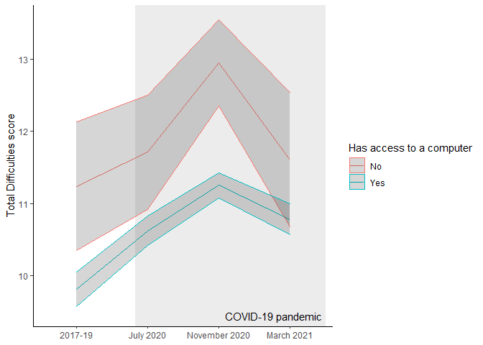
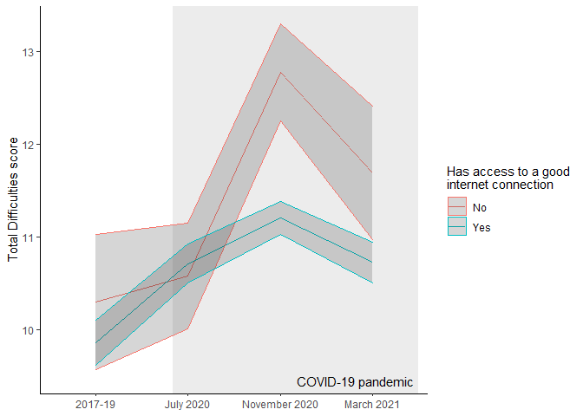
CROSS-SECTIONAL data
mean ± standard error
Notes:
*** FIVE MINUTES *** These are cross-sectional data from Understanding Society (i.e. lines display mean SDQ score +/- standard error). Notice again ‘inverted U’ shape of mean SDQ scores, but note also that this is greatly pronounced in those who don’t have access to a computer (left) or good internet connection (right).

Slide 9
LATENT GROWTH CURVE MODELLING
Establish general form of mental health trajectories
Estimate model parameters for each group
Constrain a parameter to be equal for both groups and re-estimate
Compare constrained + unconstrained models using likelihood ratio test
Notes:
Cross-sectional data are not good at telling us about the mean *trajectories* of individuals’ MH over the relevant time period. So we turn to longitudinal latent growth curve modelling to better assess this. These are the steps of the modelling process, but I want to focus first on the first step: establishing the general form of mental health trajectories…

Slide 10
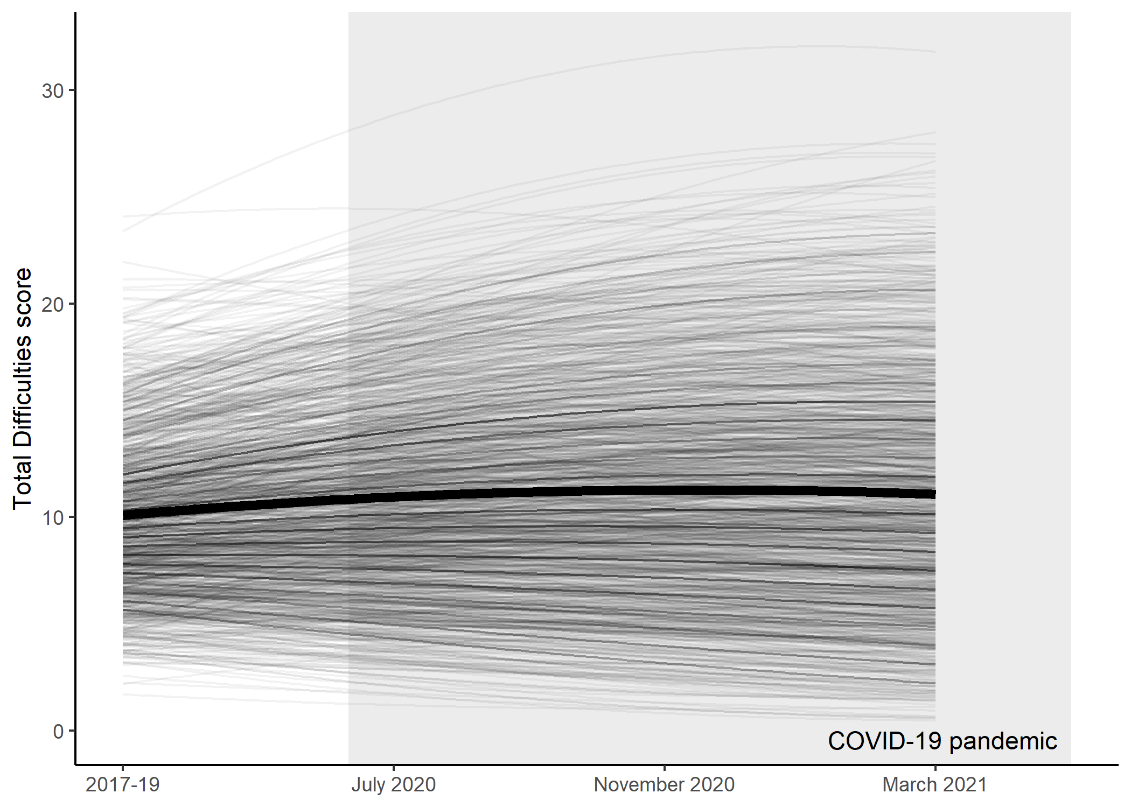
OVERALL FORM OF MENTAL HEALTH TRAJECTORIES
Metherell et al. (2021)
Notes:
I first fitted a model where adolescent mental health, then compared this to one where mental health changes linearly. These models fit significantly worse than the model shown in this figure, where the trend in mental health is quadratic (i.e. has the ‘inverted U’ shape). The peak of the trend is approximately in December 2020.

Slide 11
LATENT GROWTH CURVE MODELLING
Establish general form of mental health trajectories
Estimate model parameters for each group
Constrain a parameter to be equal for both groups and re-estimate
Compare constrained + unconstrained models using likelihood ratio test
Notes:
Now we have the general form of the adolescent MH trajectories, we can start to consider those with and without access to digital devices separately… (advance slide)

Slide 12
LATENT GROWTH CURVE MODELLING
Establish general form of mental health trajectories
Estimate model parameters for each group
Constrain a parameter to be equal for both groups and re-estimate
Compare constrained + unconstrained models using likelihood ratio test
Notes:
Once we have a trajectory for each group modelled, we can start to constrain the parameters of the model in turn so that they are the same across groups, and see whether this makes the fit of the model substantially worse. By trying this with all of the model parameters, variances and covariances (using likelihood ratio tests), we arrive at the best possible model for the data.

Slide 13
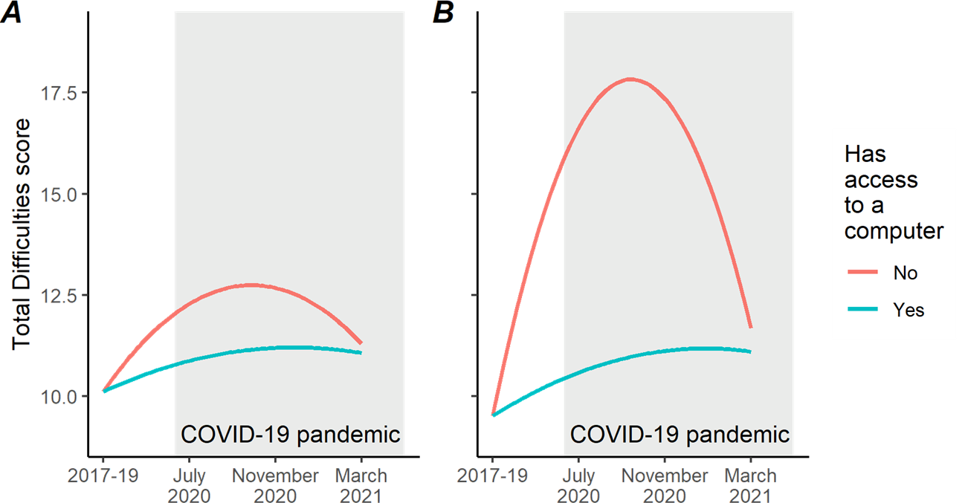
MENTAL HEALTH BY COMPUTER ACCESS
Metherell et al. (2021)
Notes:
Here is the end of that process. On the left you can see the best model of the data JUST for having access to a computer. BUT this model does not consider variables that might covary with mental health that are also available in the dataset (sex, age, ethnicity, income). Once we take these into account… (advance slide)

Slide 14
MENTAL HEALTH BY COMPUTER ACCESS
Control covariates:
Sex
Birth year
Ethnicity (White vs ethnic minority)
Mean household income across waves
Metherell et al. (2021)
Notes:
We arrive at the model on the right. Notice that, contrary to what we might expect, controlling for these variables actually increases the size of the effect. So it looks like lack of access to a computer might be causative of worse mental health among adolescents during the pandemic, but not beforehand.

Slide 15
MENTAL HEALTH BY COMPUTER ACCESS
“High” symptoms (18+)
24% / 14%
“Very high” (20+)
16% / 8%
Metherell et al. (2021)
Notes:
In terms of clinical cutoffs, note also here that the proportion of modelled adolescent trajectories entering the “high” or “very high” ranges of SDQ scores is 24% in the group without computer access cf. 14%, and the proportion entering “very high” is 16% cf. 8%.

Slide 16
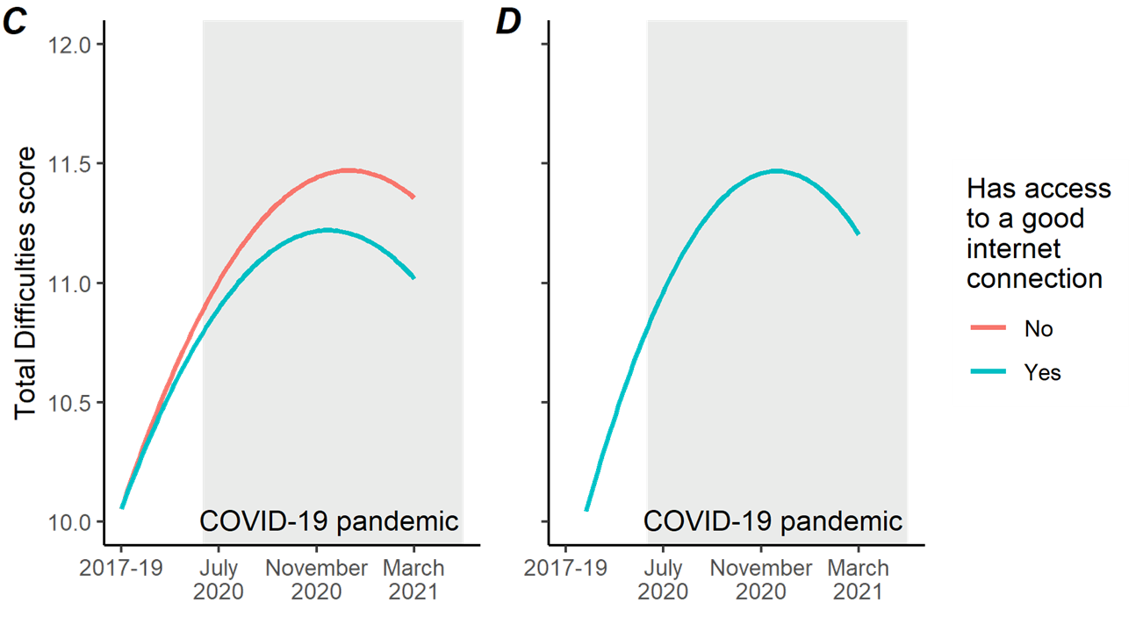
MENTAL HEALTH BY ACCESS TO A GOOD INTERNET CONNECTION
Metherell et al. (2021)
Notes:
Repeating the same process for access to a good internet connection, on the left you can see the model without control variables taken into account. On the right is with controls, and now you can see that the two lines are actually on top of one another. This is because the data do not support any difference between the modelled trajectories once we take control variables into account. So it would appear that access to a good internet connection is not predictive of worse adolescent MH. Potential reasons for this: the smaller effect size for this (what is a good internet connection?) combined with a small sample size for the digitally excluded group leads to the difference being insignificant.

Slide 17
COVID-19 FOR ADOLESCENTS
SOCIAL RESTRICTIONS
ONLINE SCHOOLING
MENTAL HEALTH CONSEQUENCES FOR DIGITALLY EXCLUDED ADOLESCENTS?
Orben et al. (2020)
Notes:
*** TEN MINUTES *** So returning to our hypothesis… (advance slide)

Slide 18
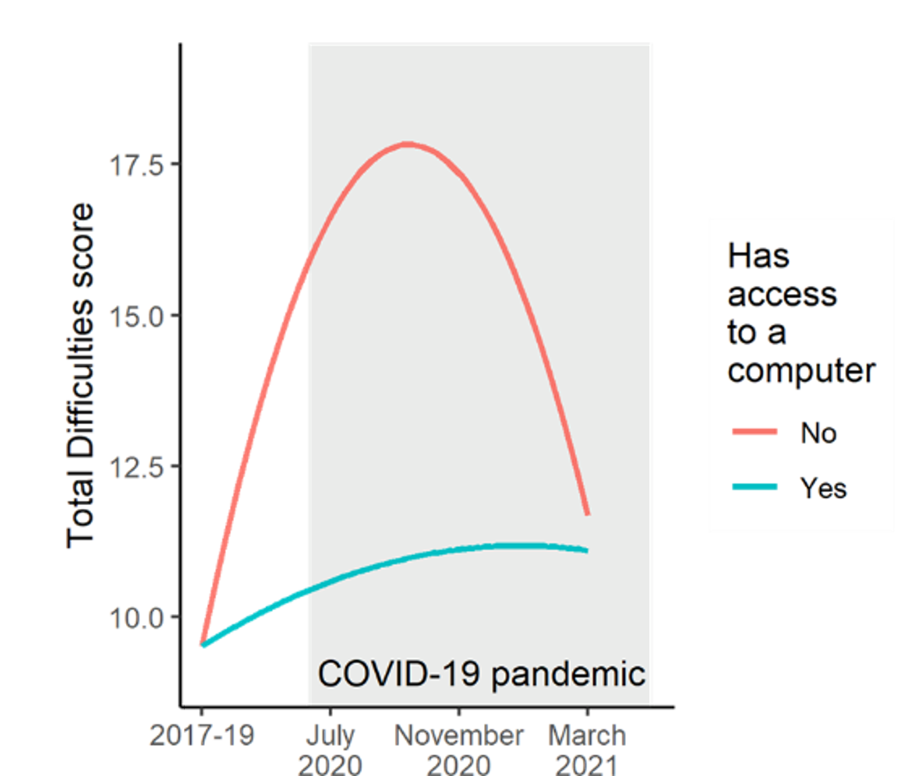
DISCUSSION: COVID-19 FOR ADOLESCENTS
SOCIAL RESTRICTIONS
ONLINE SCHOOLING
MENTAL HEALTH CONSEQUENCES FOR DIGITALLY EXCLUDED ADOLESCENTS(?)
Orben et al. (2020); Metherell et al. (2021)
Notes:
We have provided some evidence that not having access to digital devices (in this case, a computer) might have adverse mental health consequences among adolescents during COVID.

Slide 19
CAVEATS
LIMITED NUMBER OF DIGITALLY EXCLUDED PARTICIPANTS
UNEQUAL SPACING OF SURVEY WAVES
COULD NOT APPLY SAMPLE WEIGHTS
Metherell et al. (2021)
Notes:
There are some caveats to this: firstly, in the UK, the number of adolescents without access to digital devices is quite low, so the sample sizes for the digitally excluded groups are quite small (5-10% of total). Also, the survey waves are not equally spaced, which might influence the validity of the models we fit. Finally, because of the small size of the excluded groups it was not possible to validly apply survey weights, so the results are not yet fully generalisable to the UK population – e.g. ethnic minorities are oversampled in the dataset to account for higher dropout rates.

Slide 20
SIGNIFICANCE
DIGITAL TECHNOLOGIES BRING RISKS AND BENEFITS FOR YOUTH MH
DIGITAL EXCLUSION IS A RISK FACTOR DURING SOCIAL ISOLATION
IN A “DIGITAL FIRST” WORLD, EQUITABLE DIGITAL ACCESS IS NEEDED
Metherell et al. (2021)
Notes:
Finally: the significance of these findings. Our results combined with the findings of others indicate that digital technologies don’t just bring risks, but also potential benefits for adolescent mental health, particularly during times of elevated social isolation such as the COVID-19 pandemic. Digital exclusion may be a risk factor for adolescent mental health during these times, and it is therefore important to prioritise equitable digital access. Finally, as we move towards a more digitalised world, equitable digital access must become a priority in order to protect the mental health of adolescents in the future.

Slide 21
REFERENCES
Metherell, T.E., Ghai, S., McCormick, E.M., Ford, T.J., & Orben, A. (2021). Digital exclusion predicts worse mental health among adolescents during COVID-19. medRxiv. https://doi.org/10.1101/2021.11.25.21266853
Institute for Government. (2021). Timeline of UK government coronavirus lockdowns. https://www.instituteforgovernment.org.uk/charts/uk-government-coronavirus-lockdowns
University of Essex, Institute for Social and Economic Research. (2021a). Understanding Society: Waves 1-10, 2009-2019 and Harmonised BHPS: Waves 1-18, 1991-2009. [data collection]. 13th Edition. UK Data Service. SN: 6614, https://doi.org/10.5255/UKDA-SN-6614-14
University of Essex, Institute for Social and Economic Research. (2021b). Understanding Society: COVID-19 Study, 2020-2021. [data collection]. 10th Edition. UK Data Service. SN: 8644, https://doi.org/10.5255/UKDA-SN-8644-10
Orben, A., Tomova, L., & Blakemore, S.-J. (2020). The effects of social deprivation on adolescent development and mental health. The Lancet Child & Adolescent Health, 4(8), 634-640. https://doi.org/10.1016/S2352-4642(20)30186-3
Vizard, T., Sadler, K., Ford, T., Newlove-Delgado, T., McManus, S., Marcheselli, F., Davis, J., Williams, T., Leach, C., Mandalia, D., & Cartwright, C. (2020). Mental Health of Children and Young People in England, 2020. Health and Social Care Information Centre. https://files.digital.nhs.uk/CB/C41981/mhcyp_2020_rep.pdf
@tom_metherell
Notes:
Thank you! + references, reminder to look at preprint

Slide 22






THANK YOU!

